Slide 1

Java Web Application
Online E-Commerce Platform
A Full-Stack Web Solution Built with Servlets, JSP, JDBC, and MySQL
Galgotias University
PRESENTER
COLLEGE
BRANCH
Kautilya ---- 25SCSE1180001
Jeetu Sharma --- 25SCSE1410064
Lalit Kumar ---- 25SCSE1410125
B Tech CSE AIML

Slide 2


PROJECT MOTIVATION
Problem Statement & Objectives
Problem Statement
Key Objectives
Digital Commerce Shift: Traditional brick-and-mortar retail lacks 24/7 global reach.
Web Portal: Develop a responsive e-commerce platform using Java MVC.
Manual Overhead: Inventory tracking and manual order processing lead to high error rates.
Multi-Role Auth: Role-based access control for Users, Sellers, and Admins.
Vendor Management: Fragmented interaction between admins, sellers, and buyers.
Seamless Checkout: Dynamic cart management and real-time inventory updates.

Slide 3








TECH STACK
Technologies Used
Java
JSP
Servlets
JDBC
Core backend business logic engine.
Dynamic view rendering templates.
HTTP request handling controller.
Database connectivity abstraction layer.
MySQL
Apache Tomcat
Maven
Bootstrap 5
Relational data storage solution.
Web application server container.
Dependency build automation tool.
Responsive frontend framework.

Slide 4
SYSTEM DESIGN
MVC Architecture Flow
Client Request
UI Rendering
Controller Logic
Data Access
Driver Bridge
Database
Browser
JSP View
Servlet
DAO Layer
JDBC
MySQL
Model-View-Controller Separation: Servlets process business logic, JSP handles presentation markup, and DAO objects manage SQL operations via JDBC.

Slide 5
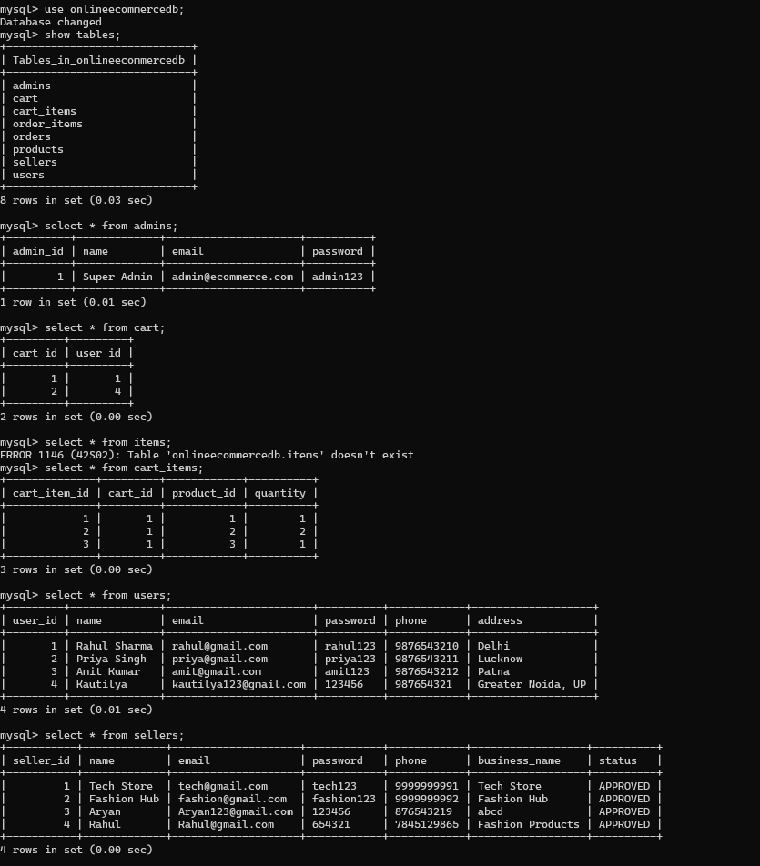

DATA LAYER
Database Schema & Tables
Admins
Credentials & platform control rights
Users
Buyer profiles, auth & addresses
Sellers
Merchant store profiles & approval status
<< Insert Database Screenshot >>
Paste MySQL Workbench / ER-Diagram Here
Products
Item details, pricing, stock & seller ID
Cart & Cart_Items
User active session sessions & line items

Slide 6
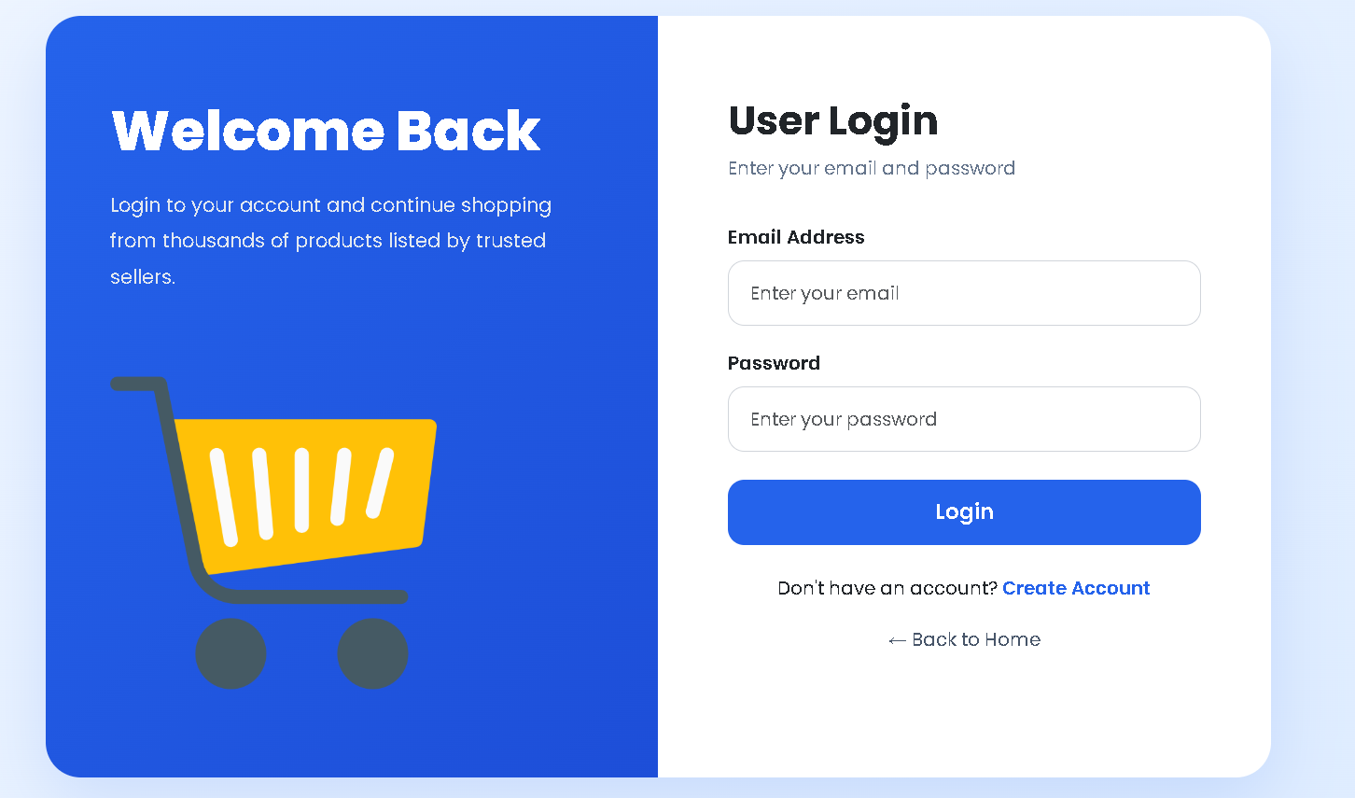


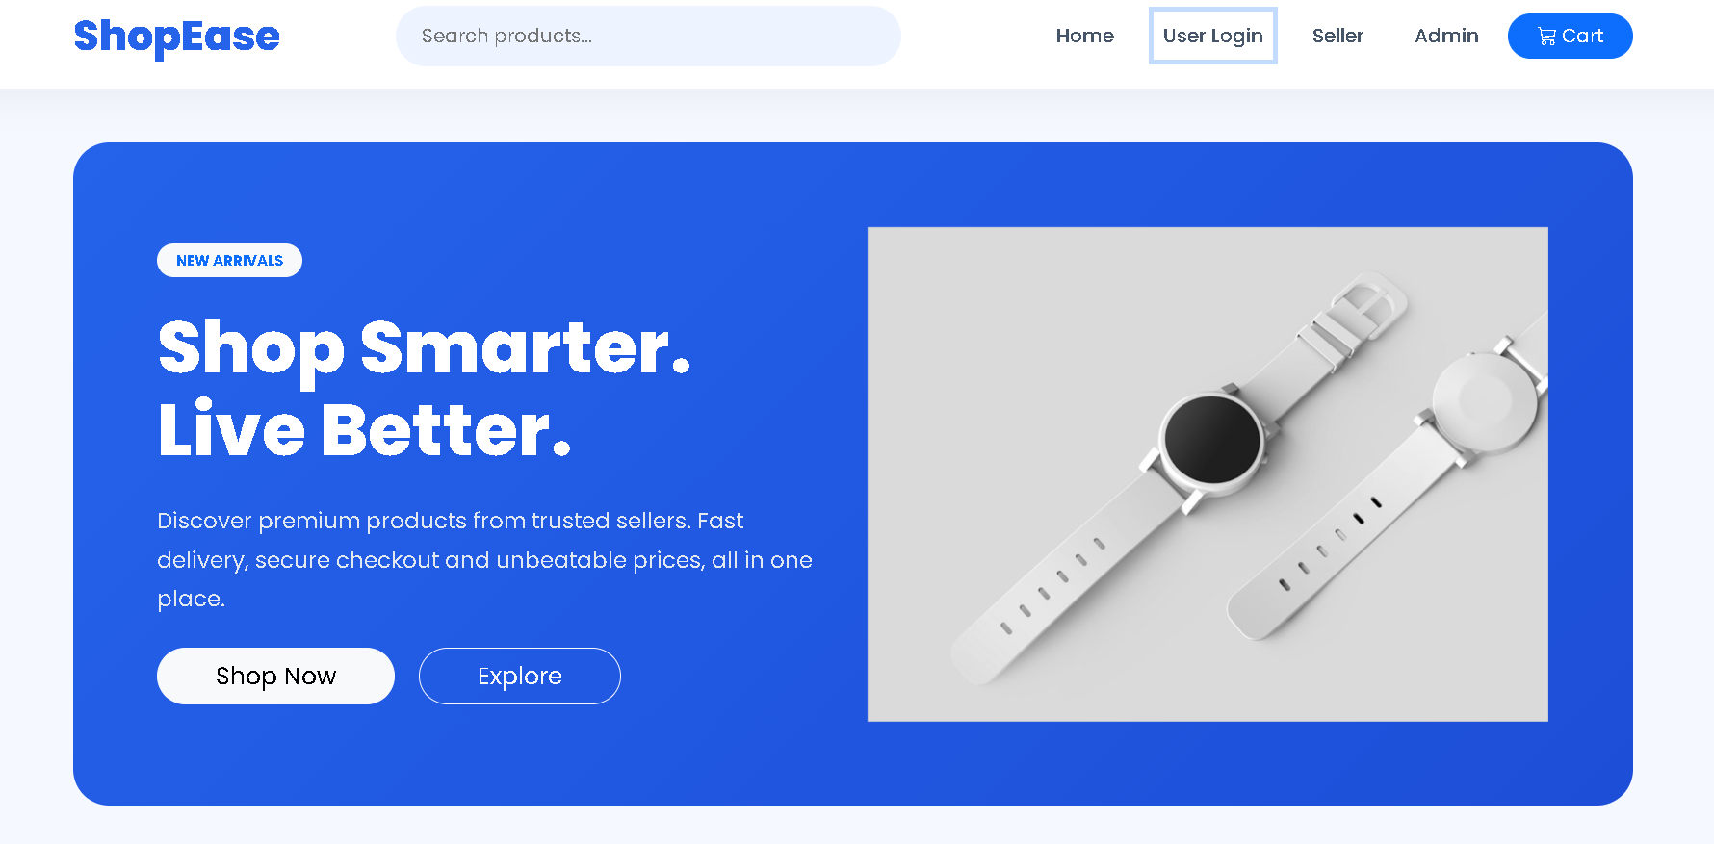


MODULE BREAKDOWN
User Module & Workflows
Authentication & Profile
User Registration, Secure Login, Profile Management, and Logout.
<< Insert User Login Screenshot >>
<< Insert Home Page Screenshot >>
Product Browsing
Interactive Home Page and Product Details with images & pricing.
Cart Operations
Dynamic Add-to-Cart and Quantity Adjustments in Shopping Cart.
<< Insert Product Details Screenshot >>
<< Insert Cart Screenshot >>

Slide 7
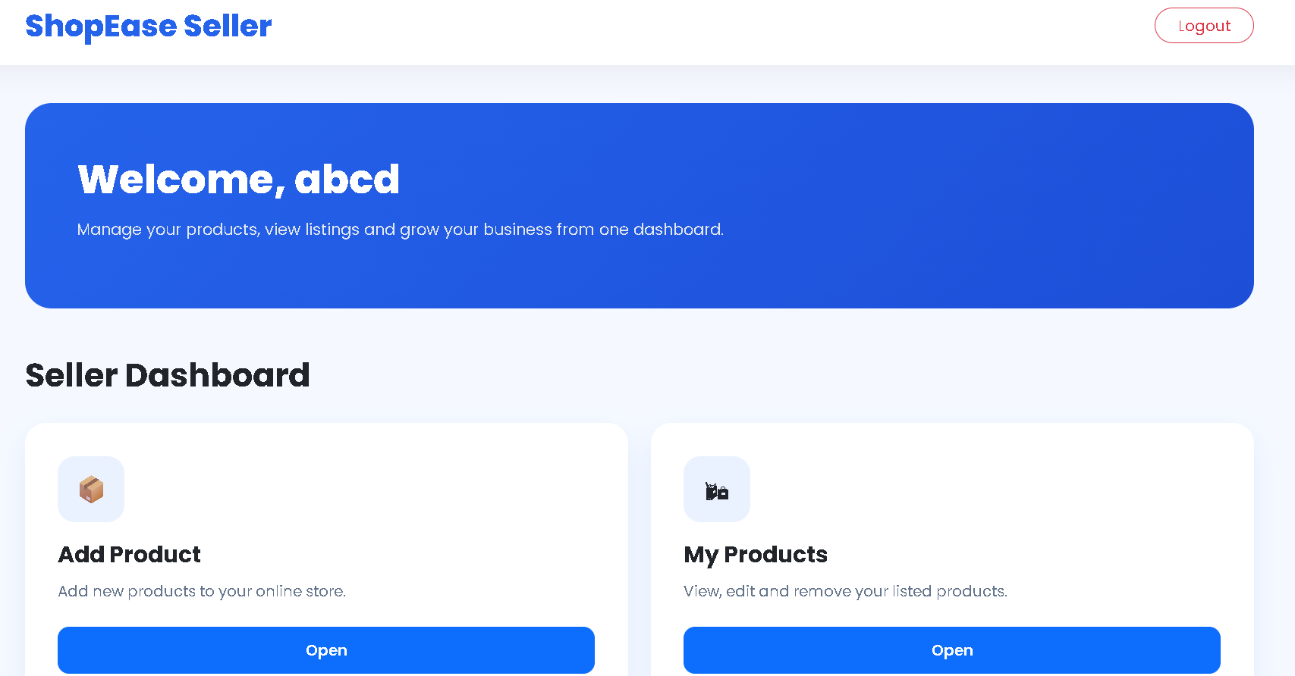


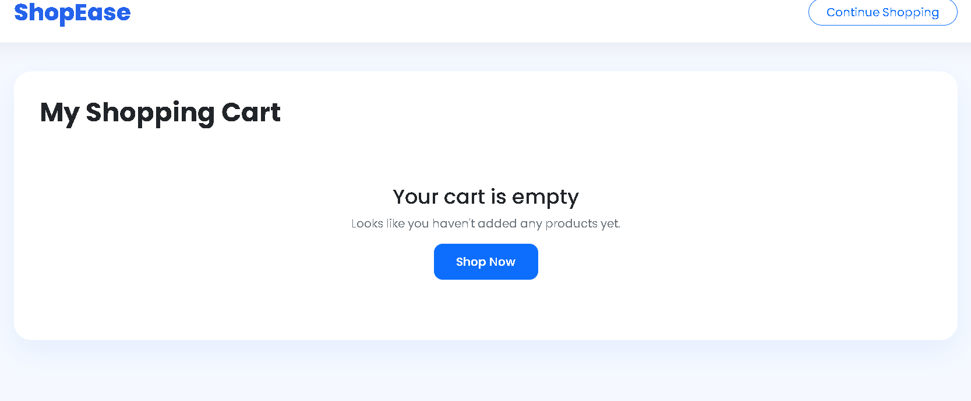

MODULE BREAKDOWN
Seller Module & Inventory Management
Seller Onboarding
<< Insert Dashboard Screenshot >>
<< Insert Add Product Screenshot >>
Registration and Login verification
Seller Dashboard
Overview of listed items & sales stats
Product Catalog Management
Add new items, view inventory & logout
<< Insert My Products Screenshot >>

Slide 8
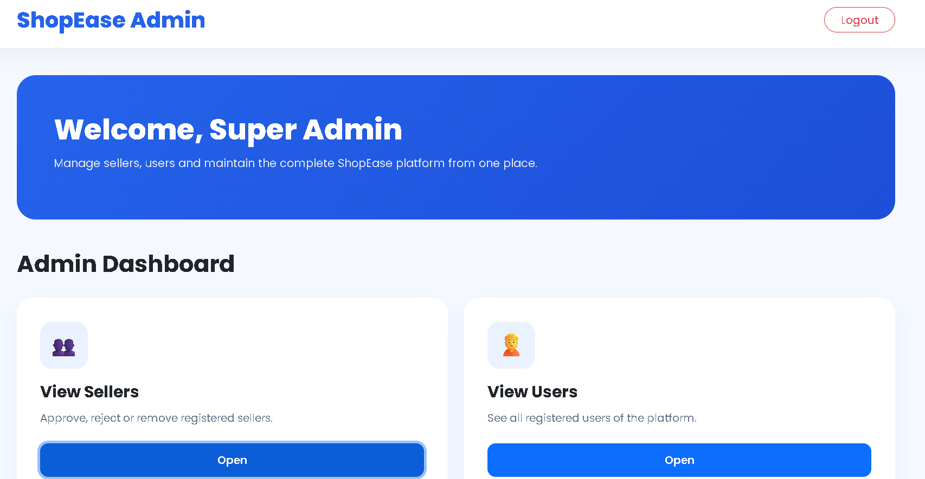

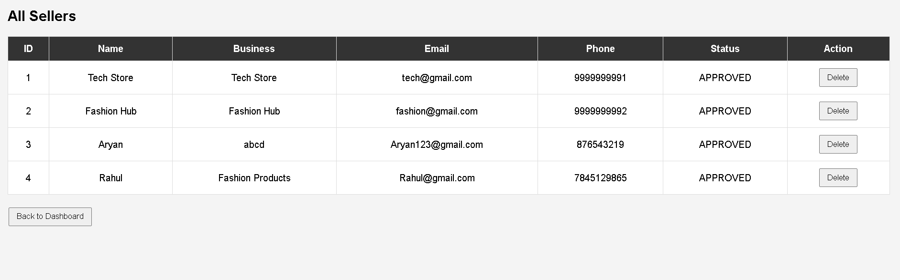

MODULE BREAKDOWN
Admin Control Panel
Admin Authentication
Secure access gateway reserved for system administrators.
<< Insert Admin Dashboard Screenshot >>
Central Dashboard
Monitor active users, total products, and system analytics.
Seller Approvals
Review pending seller registrations to approve or restrict platform access.
<< Insert Seller Approval Screenshot >>

Slide 9
DEVELOPMENT HURDLES
Challenges Faced & Resolutions
JDBC Connection Pool
Tomcat Deployment
Session Management
Managing DB connection leaks resolved via Singleton Connection Utility.
Configuring server context paths and Maven dependencies.
Handling HTTPSession objects across multi-page user flows.
Cart Integration
Servlet Mapping
Synchronizing guest session cart items with database tables.
Login & Logout State
Structuring clean web.xml / annotations URL patterns.
Preventing browser cache access after user logout.

Slide 10





ROADMAP
Future Scope & Enhancements
Online Payment Gateway Integration
Integrating Stripe / Razorpay for seamless digital payments.
Advanced Order Management
Real-time order status tracking and automated invoice generation.
Product Search & Category Filters
Dynamic keyword search with category and price range filters.
Reviews & Ratings System
Allowing verified buyers to post ratings and product reviews.
Automated Email Notifications
Sending registration confirmation and order receipts via SMTP.

Slide 11

SUMMARY
Conclusion
Project Success Highlights
The project successfully demonstrates an enterprise-ready Java Web Development stack utilizing JSP, Servlets, JDBC, and MySQL under the MVC Architecture.
Modular Code
Role-Based Controls
Extensible Design
Strict separation of View, Controller, and DAO Model layers.
Dedicated modules for Buyers, Sellers, and Platform Admins.
Prepared for payment integrations and cloud deployment.

Slide 12


Thank You!
Questions & Answers
Online E-Commerce Platform
Java Web Stack

